Slide 1

AMAZON SALES
DATA ANALYSIS REPORT
ANURAG CHAUHAN

Slide 2
Problem Statement
Objective
Benefits
Help out to make better business decisions.
Help analyze customer trends and satisfaction, which can lead to new and better products and services.
Gives better insight of customers base.
Helps in easy flow for managing resources.
Sales management has gained importance to meet increasing competition and the need
for improved methods of distribution to reduce cost and to increase profits. Sales
management today is the most important function in a commercial and business
enterprise.
Develop a Report by Extracting-Transforming-Loading of data which contains Sales trend with respect to Year, Month, Quarter and find Some relationships through data to understand and Analyze the Facts.

Slide 3
Quick Insight
﻿A quick insight for 2010 | 2011| 2012 | 2013 | 2014 | 2015 | 2016 | 2017 amazon sales.
512.87K
Sales Quantity
137.35M
Total Revenue
44.17M
Total Profit
12
Products
100
Customers

Slide 4
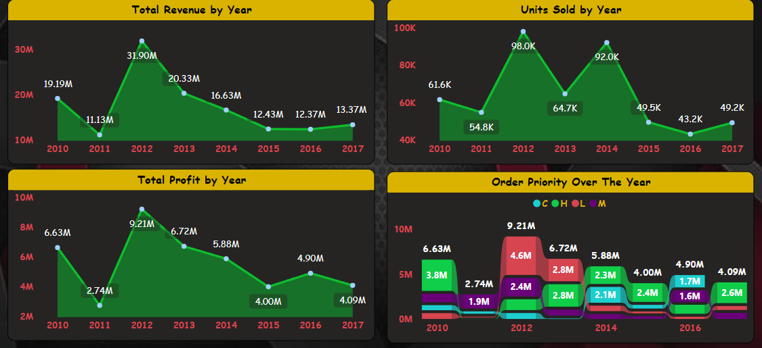
Total Sales for all the year
﻿2012 had the highest Revenue at 31.90M, followed by 2013 at 16.63M and 2010 at 19.19M and in 2011 had minimum Revenue 11.13M
﻿2012 had the highest Profit at 9.21M, followed by 2013 at 6.72M and 2010 at 6.63M and in 2011 had minimum Revenue 2.74M

Slide 5
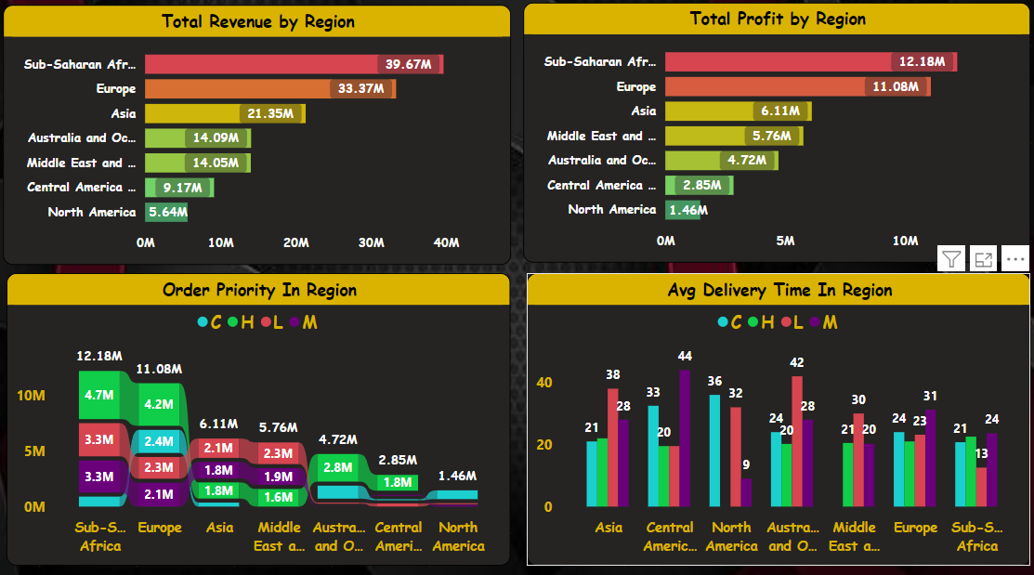
Region Wise Analysis
Region Sub - Saharan Africa had the highest Revenue and profit of 39.67M and 12.18M respectively

Slide 6
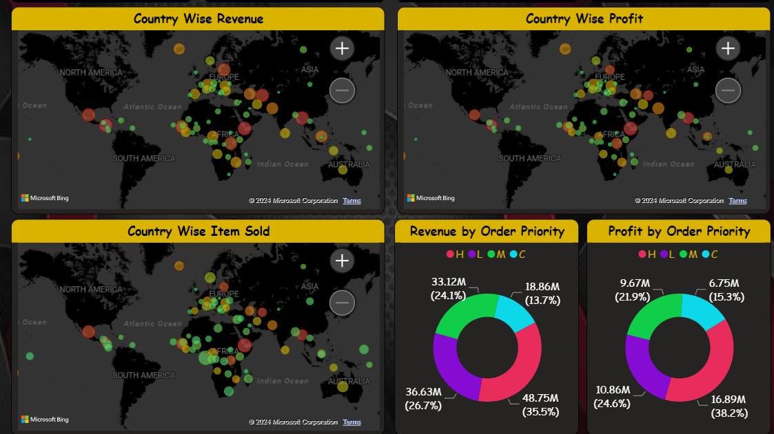
Revenue Categorized By Countries
Bigger the size shows the highest Revenue and Profit in that Country

Slide 7
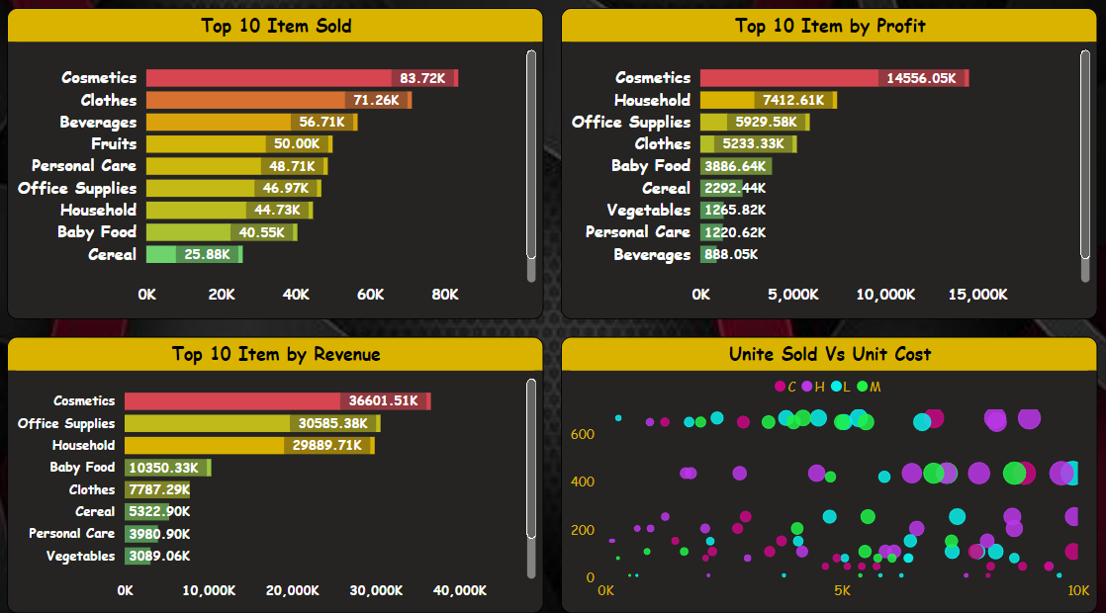
Top 10 Items
Cosmetics generated revenue of 36601.51K followed Office Supplies that’s 30585.38K

Slide 8
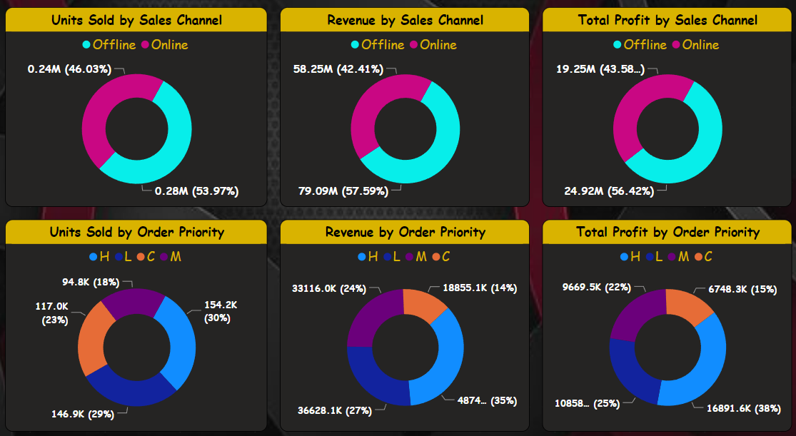
Sales Channel And Order Priority Wise Analysis
We had different information for Sales Channels and Order Priority

Slide 9
Conclusion
1. ﻿2012 had the highest Revenue at 31.90M, followed by 2013 at 16.63M and 2010 at 19.19M and in 2011 had minimum Revenue 11.13M
﻿2. 2012 had the highest Profit at 9.21M, followed by 2013 at 6.72M and 2010 at 6.63M and in 2011 had minimum Revenue 2.74M
3. Region Sub - Saharan Africa had the highest Revenue and profit of 39.67M and 12.18M respectively
4. Bigger the size shows the highest Revenue and Profit in that Country.
5. Cosmetics generated revenue of 36601.51K followed Office Supplies that’s 30585.38K
6. We had different information for Sales Channels and Order Priority
7. And many more information we got.

